Slide 1
Software Testing
Manual Testing Concepts

Slide 2
Introduction
Software Testing
Computer programs are designed and developed by human beings and hence are prone to errors.
Unchecked, they can lead to a lot of problems, including social implications.
Testing the software becomes an essential part of the software development lifecycle.
Carrying out the testing activities for projects has to be practiced with proper planning and must be implemented correctly.

Slide 3
Basic Questions on Testing
Why to test?
testing becomes absolutely essential to make sure the software works properly and does the work that it is meant to perform.
What to test?
Any working product which forms part of the software application has to be tested. Both data and programs must be tested.
How often to test?
When a program (source code) is modified or newly developed, it has to be tested.
Who tests?
Programmer, Tester and Customer

Slide 4
Software Development Lifecycle (SDLC)
Inception
Requirements
Design
Coding
Testing
Release
Maintenance

Slide 5
Inception
Request for Proposal
Proposal
Negotiation
Letter Of Intent (LOI) – some companies may do this along with a feasibility study to ensure that everything is correct, before signing contract
Contract

Slide 6
Requirements
User Requirements Specification (URS)
This document will describe in detail about what is expected out of the software product from the user's perspective.
The wordings of this document will be in the same tone that of a user
Software Requirements Specification (SRS)
A team of business analysts, who are having a very good domain or functional expertise, will go to the clients place and get to know the activities that are to be automated and prepare a document based on URS and it is called as SRS

Slide 7
Design
High Level Design (HLD)
List of modules and a brief description of each module.
Brief functionality of each module.
Interface relationship among modules
Dependencies between modules (if exists, B exists etc.)
Database tables identified along with key element.
Overall architecture diagrams along with technology details.
Low Level Design (LLD)
Details functional logic of the module, in pseudo code.
Database tables, with all elements, including their type and size
All interface details with complete API references (both requests and responses)
All dependency issues Error message Listings
Complete input and outputs for a module.

Slide 8
Coding
Converting the pseudo code into a programming language in the specified platform
Guidelines to be followed for the naming convention of procedures, variables, commenting methods etc
By compiling and correcting the errors, all syntax error and removed.

Slide 9
Testing Levels
Unit Testing
Programs will be tested at unit level
The same developer will do the test
Integration Testing
When all the individual program units are tested in the unit testing phase and all units are clear of any known bugs, the interfaces between those modules will be tested
Ensure that data flows from one piece to another piece
System Testing
After all the interfaces are tested between multiple modules, the whole set of software is tested to establish that all modules work together correctly as an application.
Put all pieces together and test
Acceptance Testing
The client will test it, in their place, in a near-real-time or simulated environment.

Slide 10
Release to Production and Warranty Period
When the clients to the acceptance testing and finds no problems, then they will accept the software and now they have to start using the software in their real office.
Bug Fixes during the warranty period – we cannot charge the customer for this
Go Live Process means the product is used in live servers

Slide 11
Maintenance Phase
Bug fixing
Upgrade
Enhancement
After some time, the software may become obsolete and will reach a point that it cannot be used. At that time, it will be replaced by another software which is superior to that. This is the end of the software
We do not use FoxPro or Windows 3.1 now as they are gone!

Slide 12
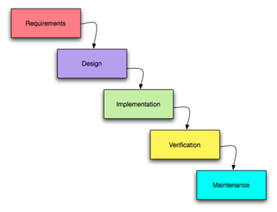
Development Models
Water Fall Model – do one phase at a time for all requirements given by customer

Slide 13
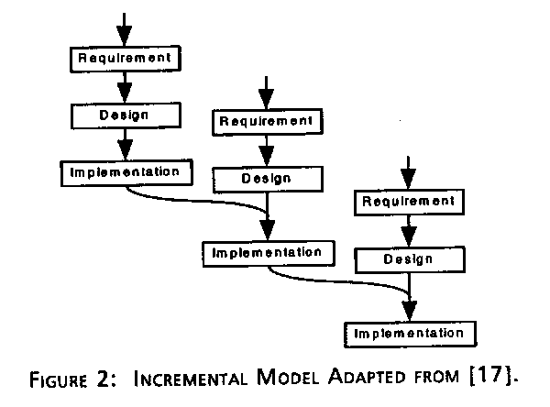
Development Models
Incremental Model – take smaller set of requirements and build slowly

Slide 14
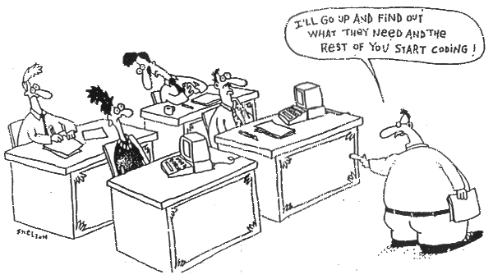
Development Models
Extreme Programming Model – take only one piece and develop!

Slide 15
Testing Vs Debugging
Testing is focused on identifying the problems in the product
Done by Tester
Need not know the source code
Debugging is to make sure that the bugs are removed or fixed
Done by Developer
Need to know the source Code

Slide 16
System Testing Process
Plan
  Create master test plan (MTP) – done by test manager or test lead
  Create Detailed Test Plan (what to test) – by testers – this will contain test scenarios also known as test conditions
  Create Detailed Test Cases (DTC) – how to test – by testers
Execute
Regress and Analyze

Slide 17
Detailed Test Plan
What is to be tested ?
  Configuration – check all parts for existence
  Security – how the safety measures work
  Functionality – the requirements
  Performance – with more users and more data
  Environment – keep product same but other settings different

Slide 18
Detailed Test Cases
The test cases will have a generic format as
below.
Test Case Id
Test Case Description
Test Prerequisite
Test Inputs
Test Steps
Expected Results

Slide 19
Detailed Test Case (DTC)
Simple Functionality – field level
Communicative Functionality – data on one screen goes to another
End-to-End Test Cases – full sequence as though the end users carry out

Slide 20
Test Execution and Fault Reports
Test Case Assignment – done by test lead
Test Environment Set-up – install OS, database, applications
Test Data Preparation – what kind of data to be used
Actual Test Execution – do it!

Slide 21
Test Environment Set-up
There must be no development tools installed in a test bed.
Ensure the right OS and service pack/patch installed.
Ensure the disks have enough space for the application
Carry out a virus check if needed.
Ensure the integrity of the web server.
Ensure the integrity of the database serves.

Slide 22
Test Data Preparation
This data can be identified either at the time of writing the test case itself or just before executing the test cases.
Data that are very much static can be identified while writing the test case itself.
Data which are dynamic and configurable need more analysis before preparation.
Preparation of test data depends upon the functionality that is being tested.

Slide 23
Actual Test Execution
Install Tests
Auto install in default mode
Does the installer check for the prequsites?
Does the installer check for the system user privileges?
Does the installer check for disk and memory space?
Does the installer check for the license agreement ?
Does the installer check for the right product key?
Does the installer installs in the default path?
Do we have different install types like custom, full, compact, fully?

Slide 24
Install Tests continued..
Cancel the installation half way thru.
Uninstall the software.
Cancel half way thru un-install.
Reinstall on the same machine. Repair an existing install on the same machine.
Does installer create folders, icons, short cuts, files, database, registry entries?
Does uninstall remove any other files that do not belong to this product?

Slide 25
Actual Test Execution
Navigation Tests
Once install complete, start the application
Move to every possible screen using menus, tool bar icons, short cut keys, or links.
Check for respective screen titles and screen fields for the existence.
Move back and forth from various screens to other forms in adhoc
Exit the application and restart the application many times

Slide 26
Core Functional Test
Build Verification Tests (BVT)
A set of test scenarios/cases must be identified as critical priority, such that, if these tests do not work, the product does not get acceptance from the test team.
Build Acceptance Tests (BAT)
This starts once the BVT is done. This involves feeding the values to the program as per the test input and then performing the other actions (like clicking specific buttons of function keys etc) in the sequence as given in the test steps.

Slide 27
Test Problem Report or Fault Report or Bug Report
TPR Id | A unique identifier across the company
TPR Description | A brief description of the problem
Date | The date on which the TPR is raised
Author | The tester who raised the TPR
Test Case Id | The test case that caused this TPR to be raised
Software Version/Build | The version number of the software that was tested and found faulty
Problem Severity | Show stopper/High/Medium/Low. This will be agreed by the lead tester and the development project manager.
Priority | High/Medium/Low. How soon to fix?
Problem Detailed Description | A description of what was tested and what happened This will be filled by the tester.
Problem Resolution | After fixing the problem, the developer fills this section, with details about the fix. Developer gives this
Assigned to | To whom the TPR is assigned to be fixed
Expected Closure | When the problem to be closed Data
Actual closure data TPR status | When the problem is actually rectified and closed This is a changing field to reflect the status of the TPR.

Slide 28
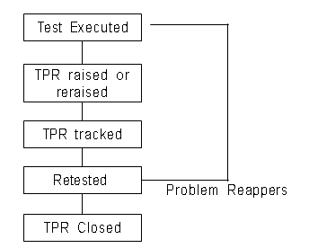
Bug Life Cycle
Do it until solved
New →
Open →
In-Fix →
Fix-Complete →
In-Retest →
Retest-Complete →
Closed
Retest-Complete →
Open

Slide 29
Test Records
When multiple testers execute test cases each tester fills up the actual results section in the test case sheets and determines whether the test has passed or failed.
These test cases along with the results will be reviewed (in peer reviews by fellow testers or by individual testers) and approved by the lead tester.
The number of such test cases executed will increase day by day, when the test cycle progress.
Each of these test case sheets will be maintained in a central location for the team members to know the progress.
The collection of such executed test case sheets along with TPRs is called test records.

Slide 30
Test Reports and Test Summary
Test Report
Individual testers will be sending their status on executing the test cases to the lead tester, on a timely basis as described in the test plan document.
Test Case ID | Pass/Fail | Date of last execution | Executed By | Actual Results

Slide 31
Test Reports and Test Summary
Test Summary
The senior management would like to get a global
picture on all projects in terms of numbers.
Test Case Summary :
Total Number of test cases
Number of test cases executed
Number of test cases passed
Number of test cases failed
TPR Summary :
Number of TPRs generated
Number of TPRs open
Number of TPRs in work
Number of TPRs closed

Slide 32
Bug Tracking Tools
Softsmith’s QAMonitor and SPCG
Bugzilla
HP Quality Center
JIRA

